Slide 1
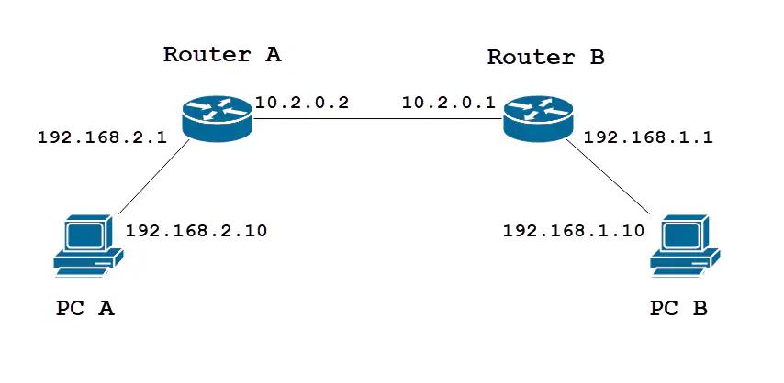
Practical
Static Routing

Slide 2
What is static Routing ?
Static routing is a form of routing that occurs when a router uses a manually-configured routing entry, rather than information from dynamic routing traffic.
In many cases, static routes are manually configured by a network administrator by adding in entries into a routing table, though this may not always be the case.

Slide 3
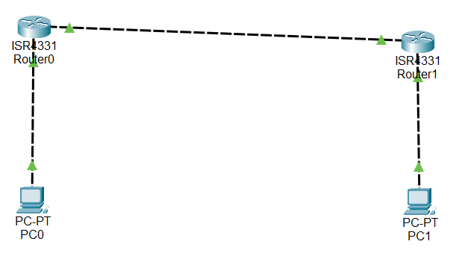
Implementation of Simple Example of static Routing on cisco packet tracer.

Slide 4
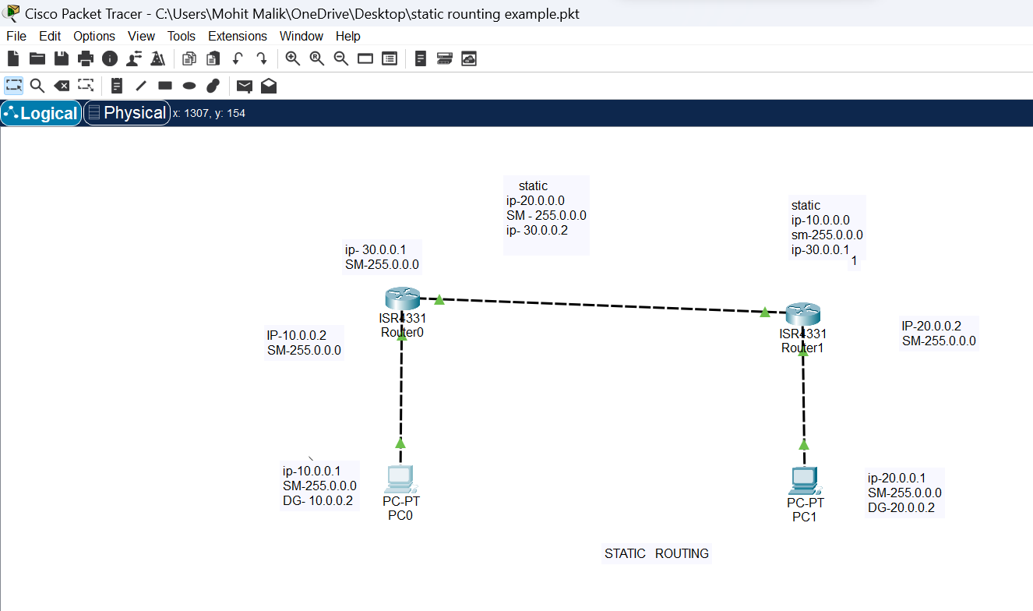

Slide 5
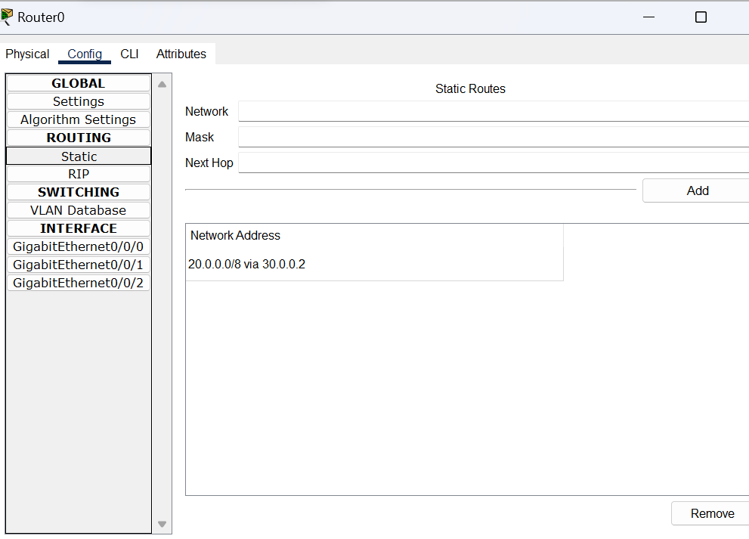

Slide 6
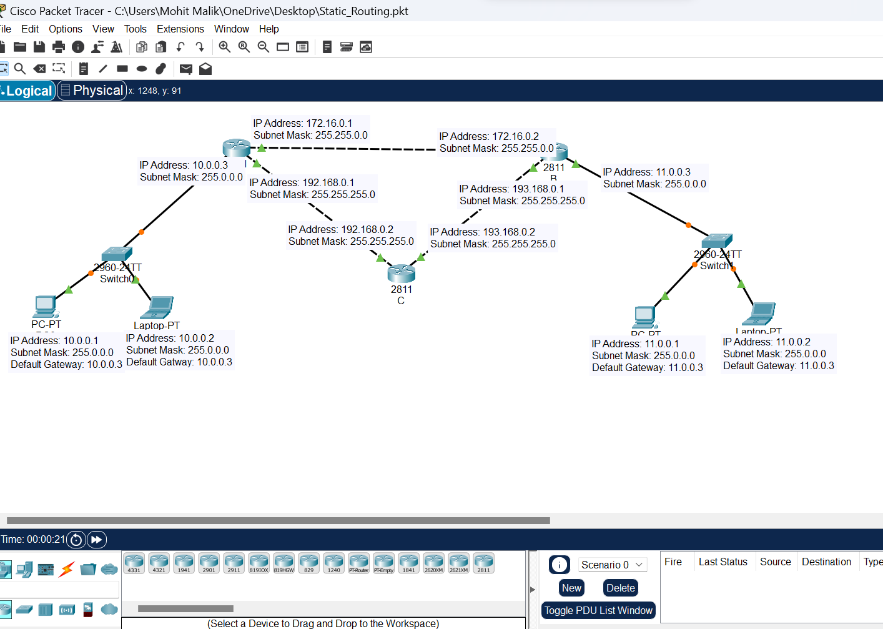
Implementation of static routing example 2 on cisco packet tracer.

Slide 8
Router A configuration
--- System Configuration Dialog ---
Would you like to enter the initial configuration dialog? [yes/no]: no
Press RETURN to get started!
Router>enable
Router#configure terminal
Enter configuration commands, one per line. End with CNTL/Z.
Router(config)#hostname A
A(config)#interface fa1/0
A(config-if)#ip address 10.0.0.3 255.0.0.0
A(config-if)#no shutdown
A(config-if)#
%LINK-5-CHANGED: Interface FastEthernet1/0, changed state to up
%LINEPROTO-5-UPDOWN: Line protocol on Interface FastEthernet1/0, changed state to up

Slide 9
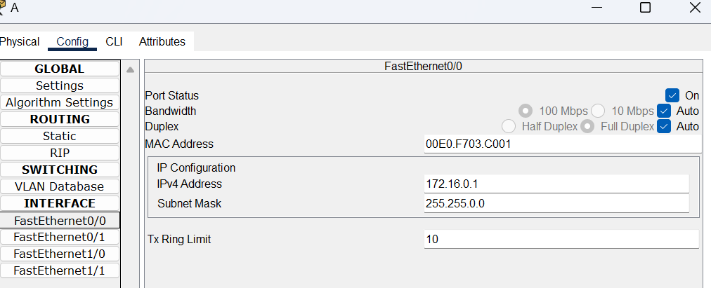
Router A Ipv4 configuration .

Slide 10
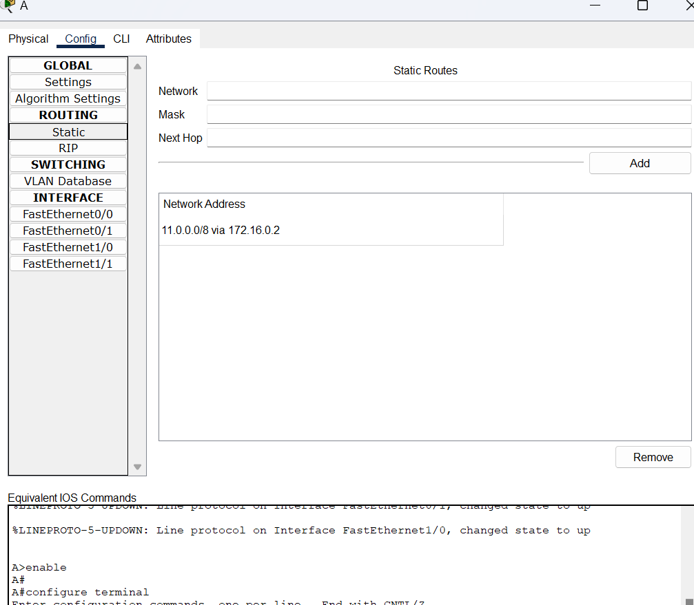
How to give path in static routing ?

Slide 11
Static Routing.
Example: 1
PATH = Network 10.0.0.0 -> Router A -> Router B -> Network 11.0.0.0
Static routing commands on each router for example 2.
A(config)#ip route 11.0.0.0 255.0.0.0 192.168.0.2
A(config)#
B(config)#ip route 10.0.0.0 255.0.0.0 193.168.0.2
B(config)#

Slide 12
Static routing commands on each router for example 2 .
A(config)#ip route 11.0.0.0 255.0.0.0 192.168.0.2
A(config)#
B(config)#ip route 10.0.0.0 255.0.0.0 193.168.0.2
B(config)#

Slide 13
Ping Command apply on destination address.

Slide 14
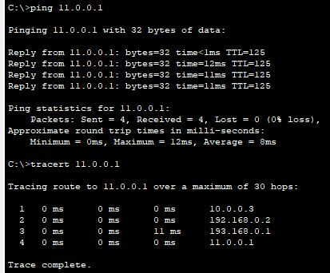
Ping command apply on destination address.

Slide 15

Thanks

